Slide 1
Components of an Industrial Robot
IMSE 381 - Lecture 2
IMSE381
Notes:
IMSE 381
E. ORADY

Slide 2
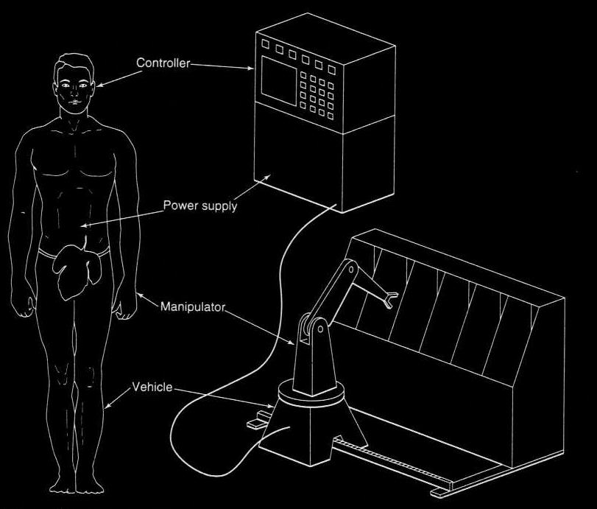
Components of a Robot System
Source J. L. Fuller
Source: J. L. Fuller
IMSE381
Notes:
IMSE 381
E. ORADY

Slide 3
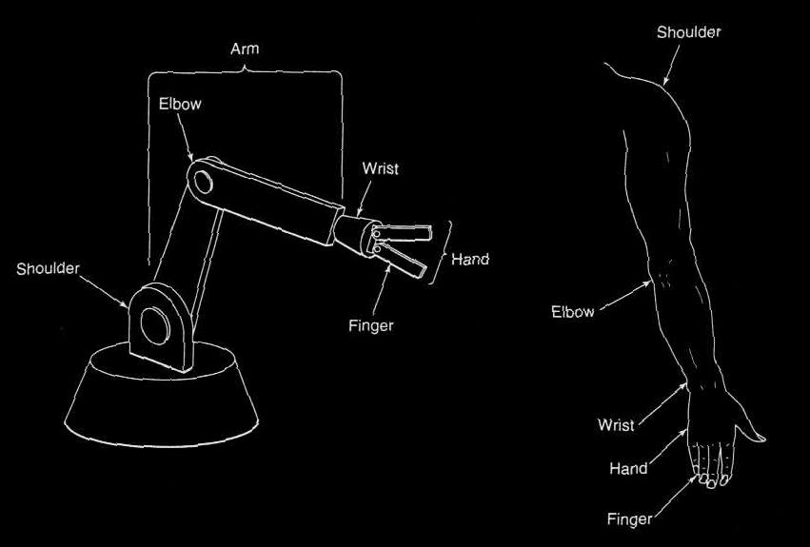
Robot Anatomy
Source J. L. Fuller
Source: J. L. Fuller
IMSE381
Notes:
IMSE 381
E. ORADY

Slide 4
Robot Manipulator Configuration
Five Basic Robot Configuration
  Cartesian coordinate robots
  Cylindrical coordinate robots
  Spherical or Polar coordinate robots
  Jointed arm robots
  SCARA robots
IMSE381
Notes:
IMSE 381
E. ORADY

Slide 5
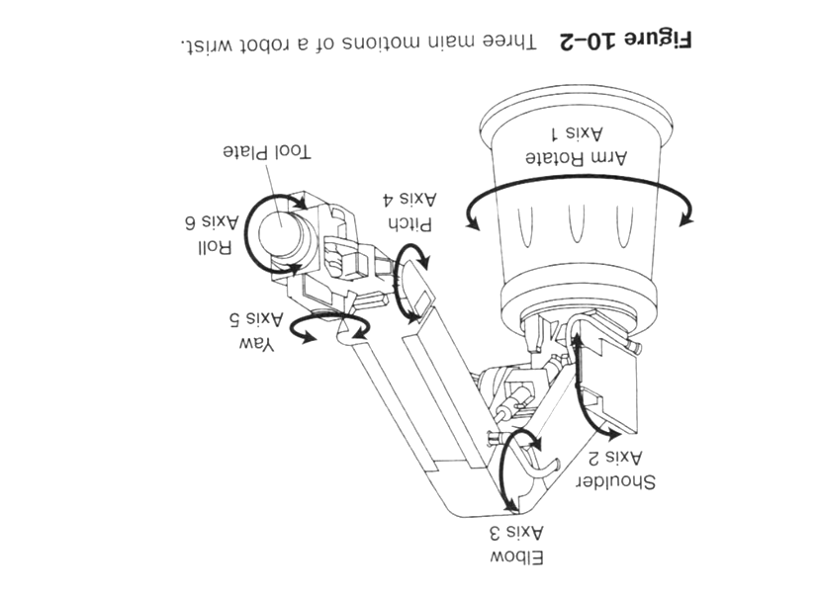
Motions of a Robot Wrist
IMSE381
Notes:
IMSE 381
E. ORADY

Slide 6

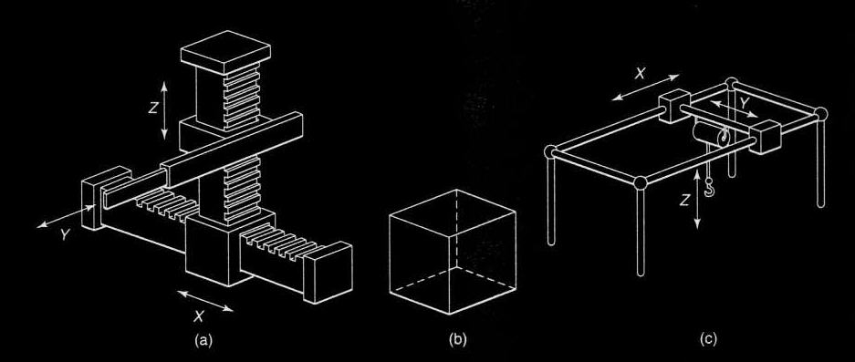
Cartesian coordinate Robots
Three Linear axes x,Y, and Z
Overhead Crane
Rectangular Work
Envelope
IMSE381
Source J. L. Fuller
Notes:
IMSE 381
E. ORADY

Slide 7
Cartesian Coordinate Robots
Three perpendicular axes X, Y, Z
All axes are linear
Axes are referred to as “prismatic”
Types:
    Cantilever Cartesian
    Gantry-style Cartesian
IMSE381
Notes:
IMSE 381
E. ORADY

Slide 8
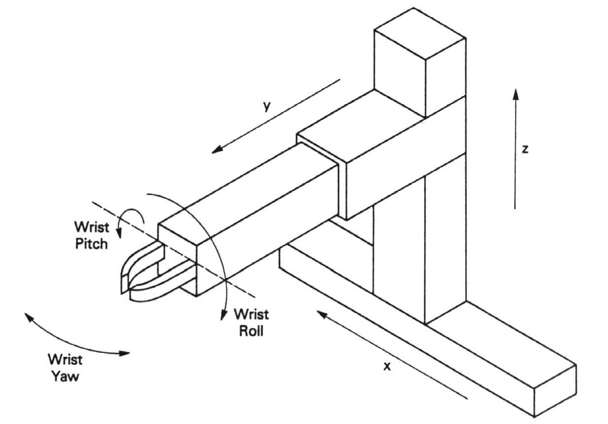
Cartesian Coordinate Robots
Cantilever Cartesian
  Arm is connected to a column which is connected to the base
  The elements of the manipulators are constrained to move in the three basic Cartesian directions; x-, y-, and z-.
  Low rigid and has restrained work space as compared to other robots
  It has good repeatability and accuracy
  It is easy to program
Source: J. L. Fuller
Cantilever Cartesian Robot
IMSE381
Notes:
IMSE 381
E. ORADY

Slide 9
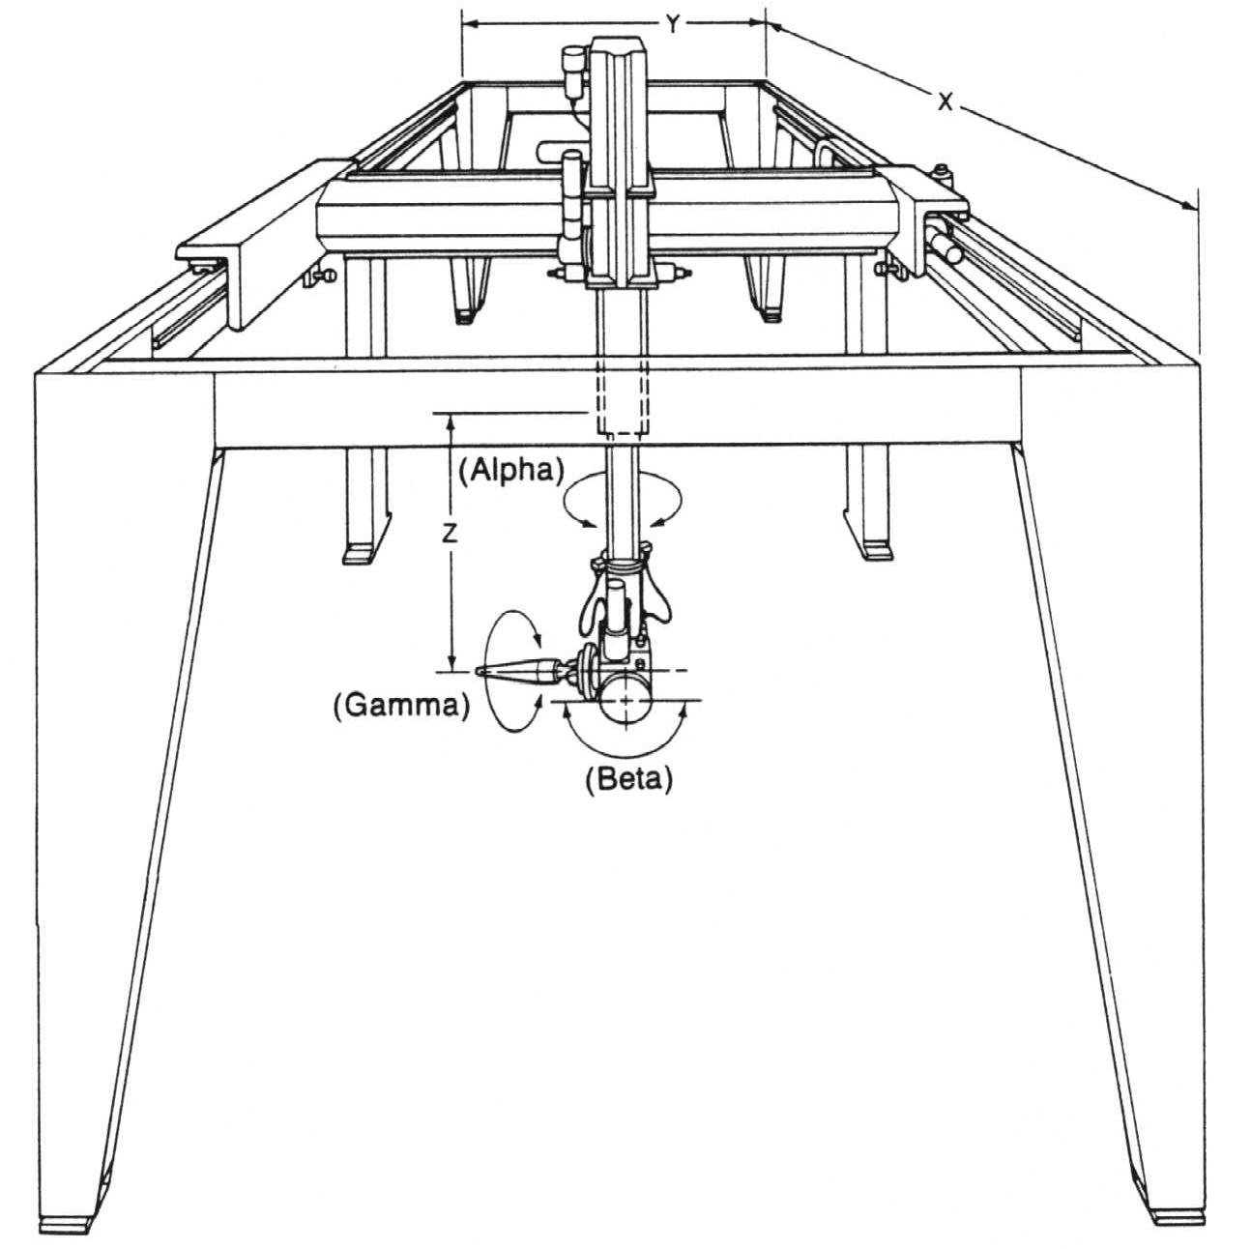
Cartesian Coordinate Robots
Gantry-Style Cartesian
  Suitable for heavy loads
  Very rigid
  Has constrained work space
  Generally mounted to a ceiling
  Easy to program
  Commonly used in machining systems
Source: Klafter, Chmielewski, and Negin
IMSE381
Notes:
IMSE 381
E. ORADY

Slide 10
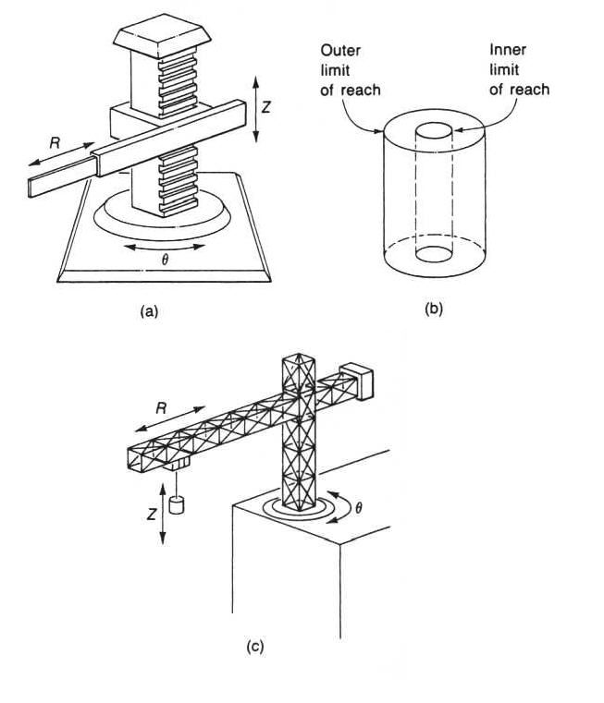
Cylindrical Coordinate robots
Consists of a rotating base, a column, and a horizontal arm
The arm moves in and out in the R direction
The carriage moves up and down in the Z- direction
The arm and carriage assembly can rotate as a unit on the base in the θ direction.
Work envelope is a portion of cylinder.
Work Volume
Cylindrical Coordinate Arm
Construction Crane
IMSE381
Source: J. L. Fuller
Notes:
IMSE 381
E. ORADY

Slide 11
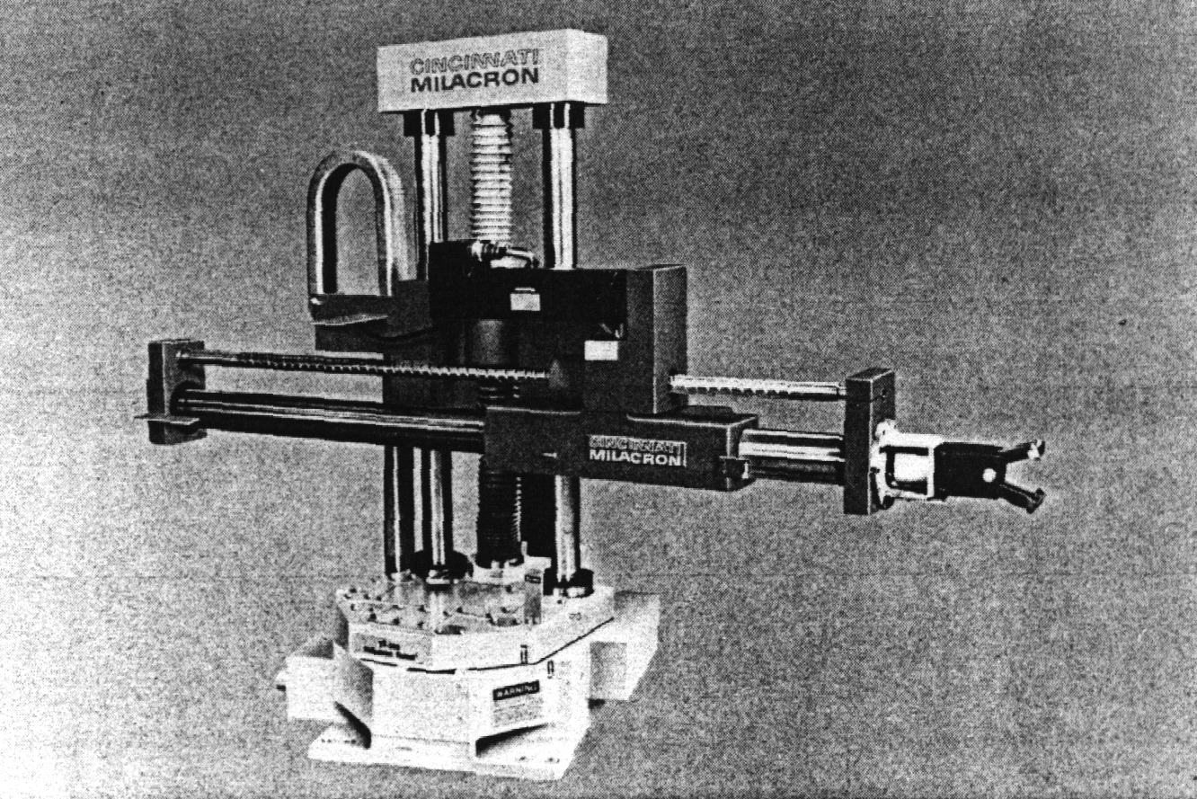
Cylindrical Coordinate Robots
Cylindrical-Coordinates Robot From Cincinnati Milacron
IMSE381
Source: J. L. Fuller
Notes:
IMSE 381
E. ORADY

Slide 12
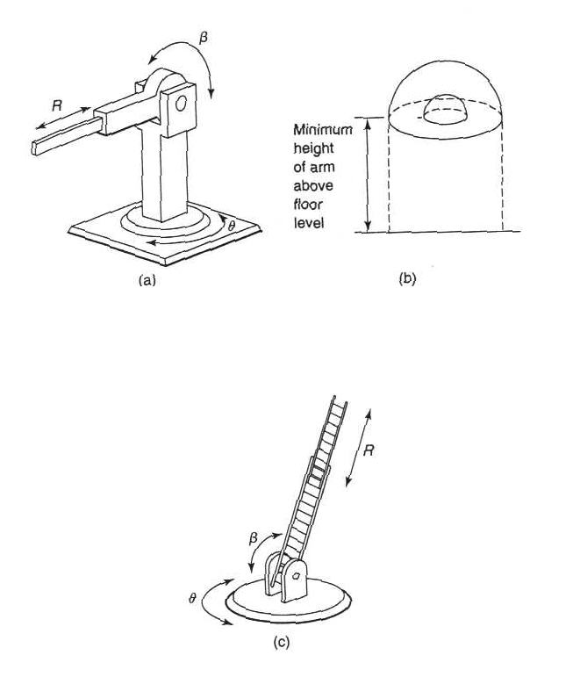
Spherical Coordinate Robots
Consists of telescopic arm, column and base.
The telescopic arrangement enables the arm to move in and out in the R direction,
The arm is pivoted on the column in a vertical plane, thus it can move up and down in the β direction,
The arm can also rotate in the horizontal plane about the base in θ direction.
Work volume is a portion of a sphere.
Source: J. L. Fuller
Polar-coordinate
Manipulator
Work-volume
Ladder on a Hook-and-Ladder truck
IMSE381
Notes:
IMSE 381
E. ORADY

Slide 13
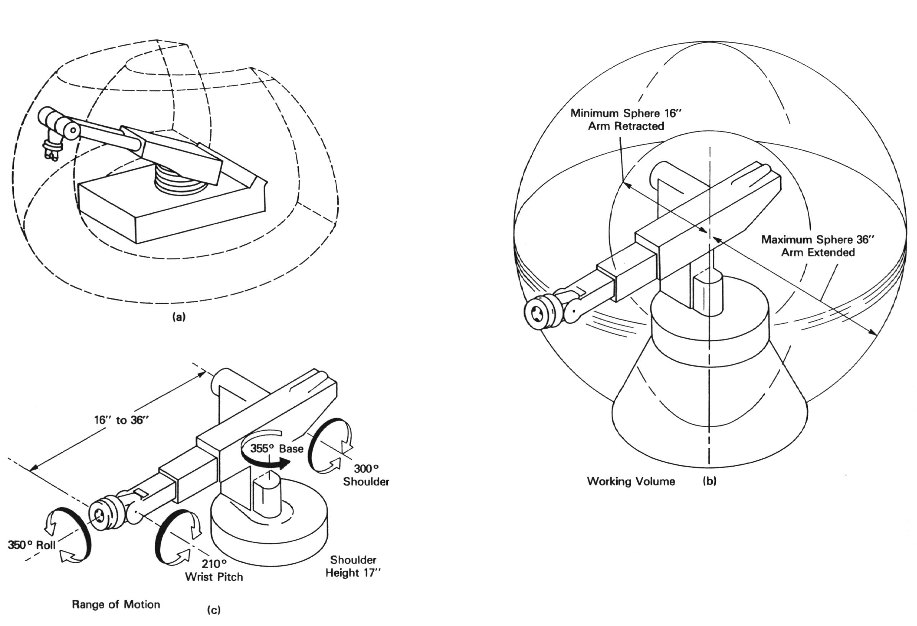
Spherical Coordinate Robots
View of Robot Major Axes
Working Volume
Range of Motion of the Five Axes
Source: J. L. Fuller
IMSE381
Notes:
IMSE 381
E. ORADY

Slide 14
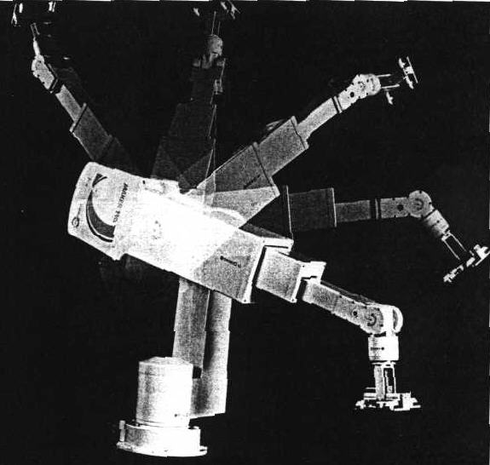
Spherical Coordinate Robots
Maker 110 Pure Spherical
Geometry Robot. It has
Five-electrically
servo-controlled axes
and can lift up to 10 lb.
Source: Klafter, Chmielewski, and Negin
IMSE381
Notes:
IMSE 381
E. ORADY

Slide 15
Jointed arm robots
Three basic types
  Pure spherical
  Parallelogram spherical
  Cylindrical
IMSE381
Notes:
IMSE 381
E. ORADY

Slide 16
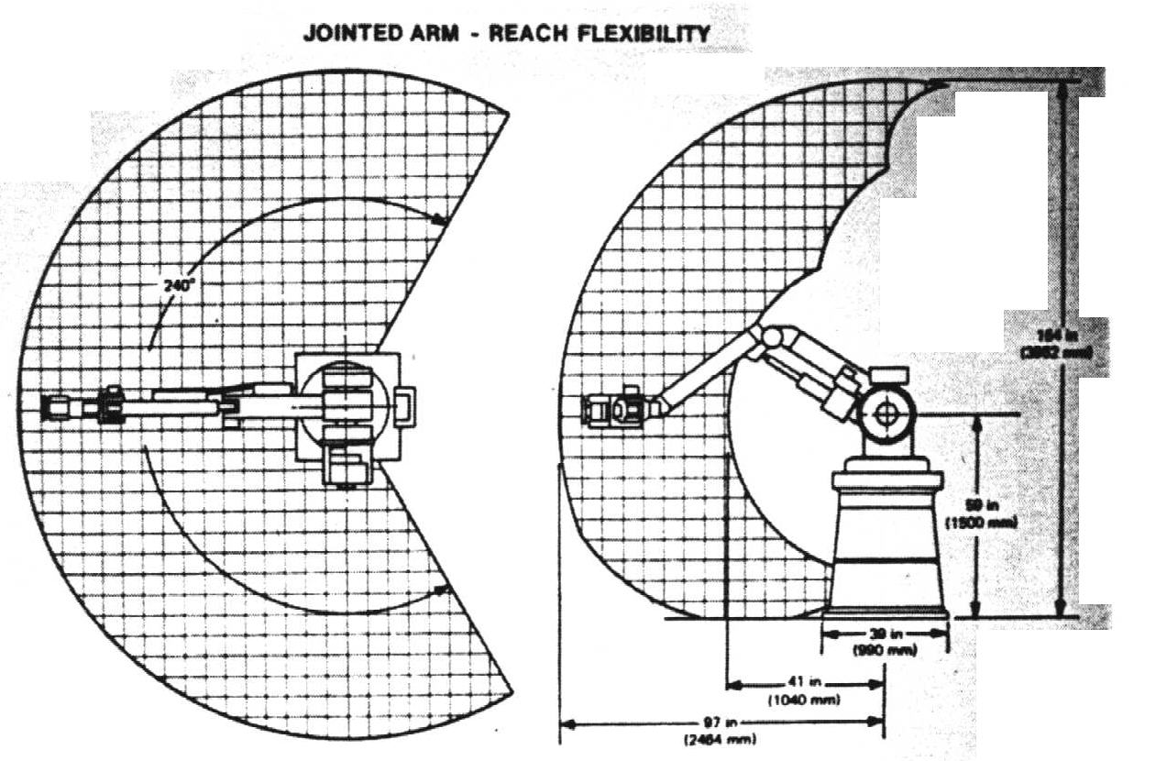
Jointed arm robots - Pure Spherical
Most common in jointed arm configuration
All links are pivoted thus they can move in a rotary or revolute motion
It has flexible motion and good reach
Robot consists of a base, elbow, and forearm.
The basic motions constitute a spherical envelope.
Geometry of Pure Spherical Jointed Arm Robot
Source: Klafter, Chmielewski, and Negin
IMSE381
Notes:
IMSE 381
E. ORADY

Slide 17
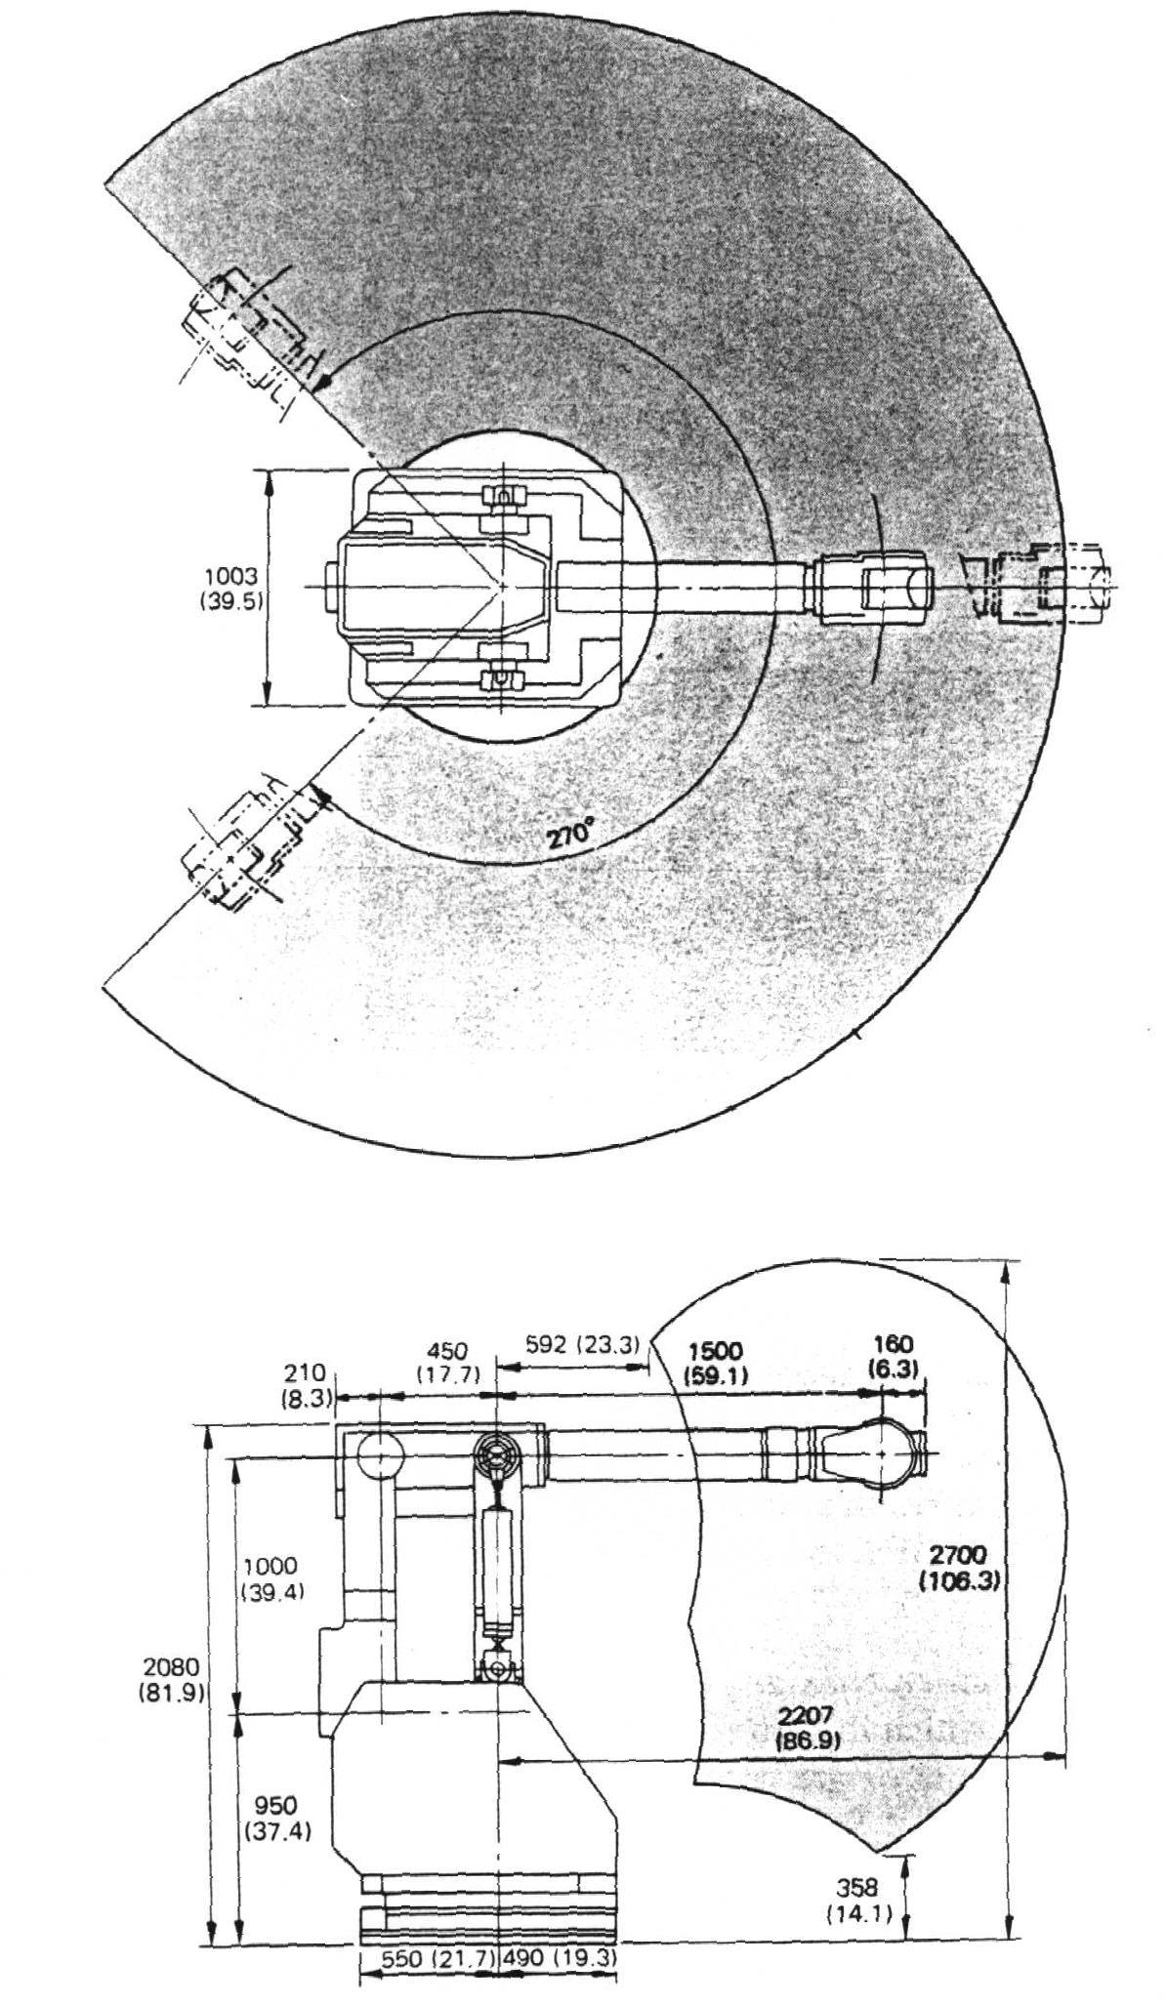
Jointed arm Robots - Parallelogram jointed
Workspace
Parallelogram spherical
  The upper arm is replaced by a multiple closed-linkage arranged in a form of parallelogram
Geometry
IMSE381
Source: Klafter, Chmielewski, and Negin
Courtesy of Toshiba/Houston Int’l
Notes:
IMSE 381
E. ORADY

Slide 18
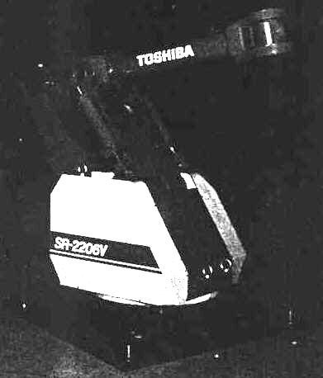
Jointed arm Robots - Parallelogram Spherical
Source: Klafter, Chmielewski, and Negin
Example of an actual parallelogram spherical jointed arm
Manufactured by Toshiba
It has six-servo controlled axes
Can left up to 120 kg
Has repeatability up to ± 1 mm
IMSE381
Courtesy of Toshiba/Houston Int’l
Notes:
IMSE 381
E. ORADY

Slide 19
Jointed arm Robots - Parallelogram Spherical
Advantages:
  Permits joint actuators to be placed close to or on the base instead of the arm links. This arrangement leads to:
    reduced inertia of the robot links
    increased pay load for the same size actuators
    a stiffer manipulator
Disadvantages
  Limited workspace as compared to jointed spherical
IMSE381
Notes:
IMSE 381
E. ORADY

Slide 20
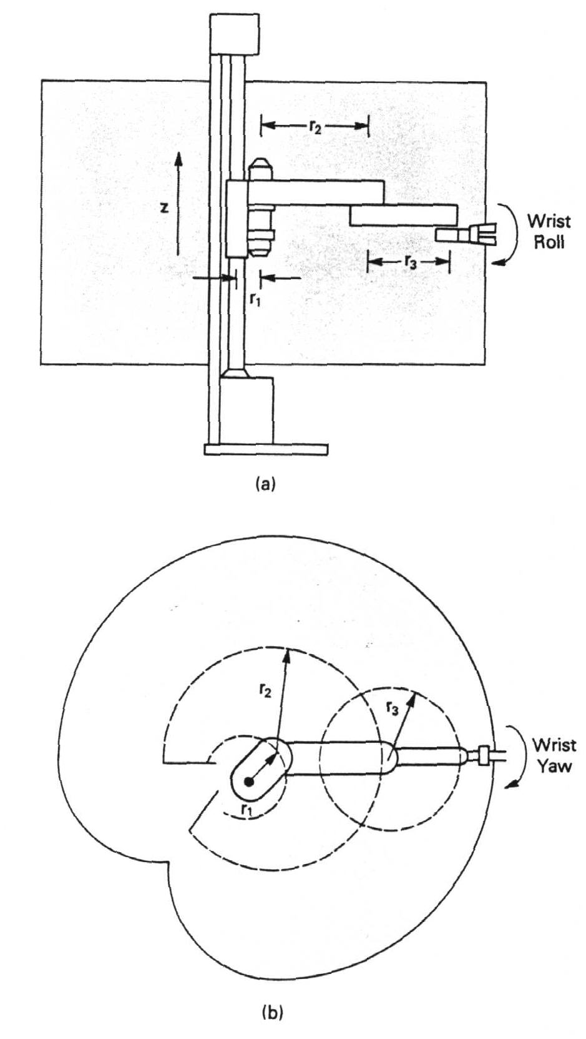
Jointed arm Robots - Jointed Cylindrical
Jointed Cylindrical Geometry
The r-axis of the pure cylindrical arm is replaced by a multiple-linked open kinematic chain
Precise and fast
Has limited vertical reach
Z- axis is simply controlled, open-loop control, while other axes use elaborate electronic control (closed loop)
A subset of cylindrical manipulators is the SCARA (Selective Compliance Assembly Robot Arm) type robot
Workspace
IMSE381
Source: Klafter, Chmielewski, and Negin
Notes:
IMSE 381
E. ORADY

Slide 21
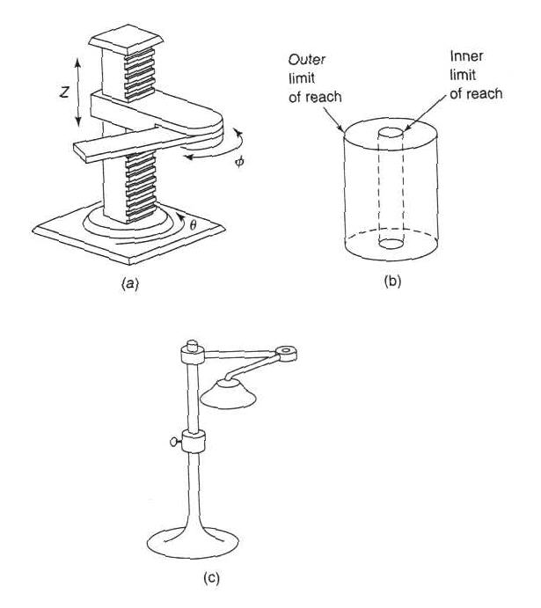
SCARA Robot
SCARA (Selective Compliance Assembly Robot Arm)
Has similar work volume like cylindrical robots
The reach axis moves parallel to the floor, which makes it capable to avoid some obstacles
More compact than cylindrical robots
Geometry
Work Volume
Folding Lamp Movement
IMSE381
Source: J. L. Fuller
Notes:
IMSE 381
E. ORADY

Slide 22
SCARA Robots
Advantages
  Relatively inexpensive
  Used in applications that require rapid and smooth motions
  Very useful in assembly operations, because it is extremely stiff in the vertical directions, and has lateral compliance, thereby facilitate insertion process
IMSE381
Notes:
IMSE 381
E. ORADY

Slide 23
Relative Advantages of Robot Configurations
Repeatability of Motion | Cartesian
Reach | Spherical and Jointed Arm
Lift Capacity | Cylindrical and Cartesian
Machine Loading & Unloading | Cylindrical and Spherical
Assembly | SCARA Robot
IMSE381

Slide 24
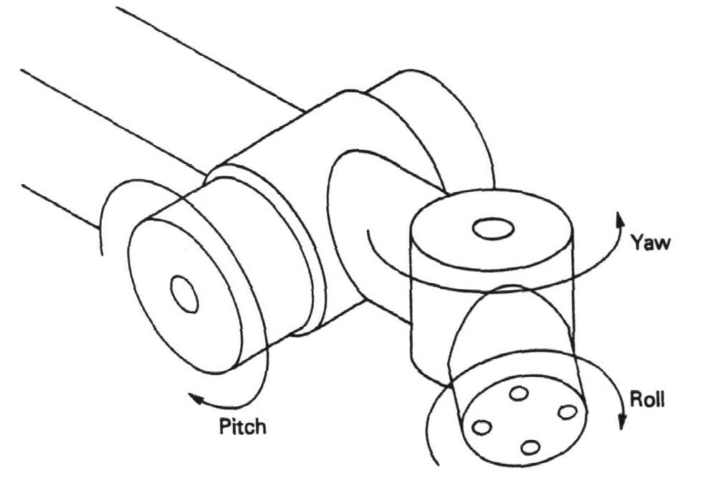
Robot Wrist
Robot wrist provide extra degrees of freedom in addition to the basic three d.o.f.
Wrist can provide up to three motions:
  Roll: Motion in a plane perpendicular to the end of the arm
  Pitch: Motion in vertical plane passing through the arm
  Yaw: Motion in a horizontal plane that also passes through the arm
A Three-degrees Wrist
Source: J. L. Fuller
IMSE381
Notes:
IMSE 381
E. ORADY

Slide 25
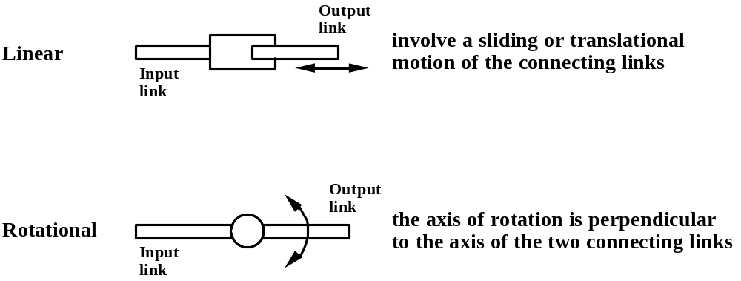
Robot Notation Based on Motion
Types of Joints in Robotics
(L)
L
R
(R)
Source: Groover
IMSE381
Notes:
IMSE 381
E. ORADY

Slide 26
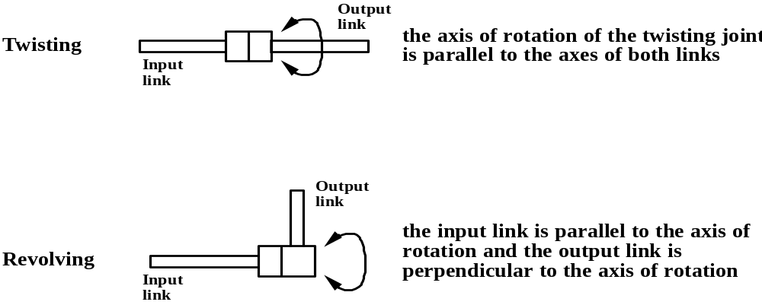
Types of Joints in Robotics
(T)
T
(V)
V
Source: Groover
IMSE381
Notes:
IMSE 381
E. ORADY

Slide 27
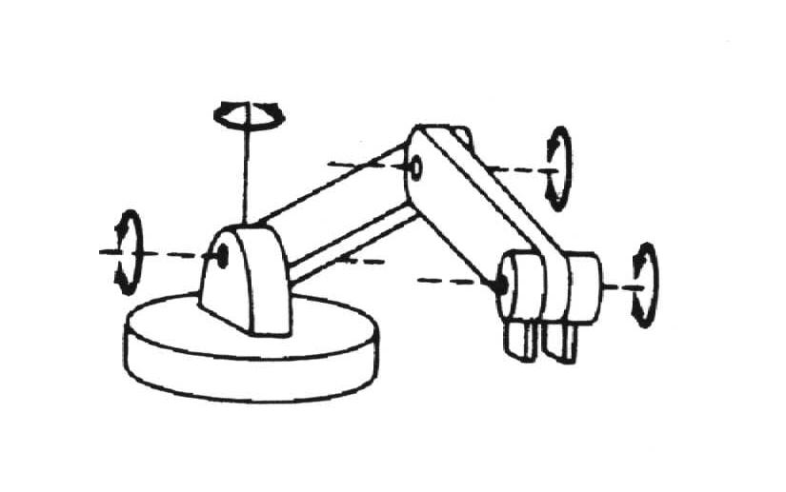
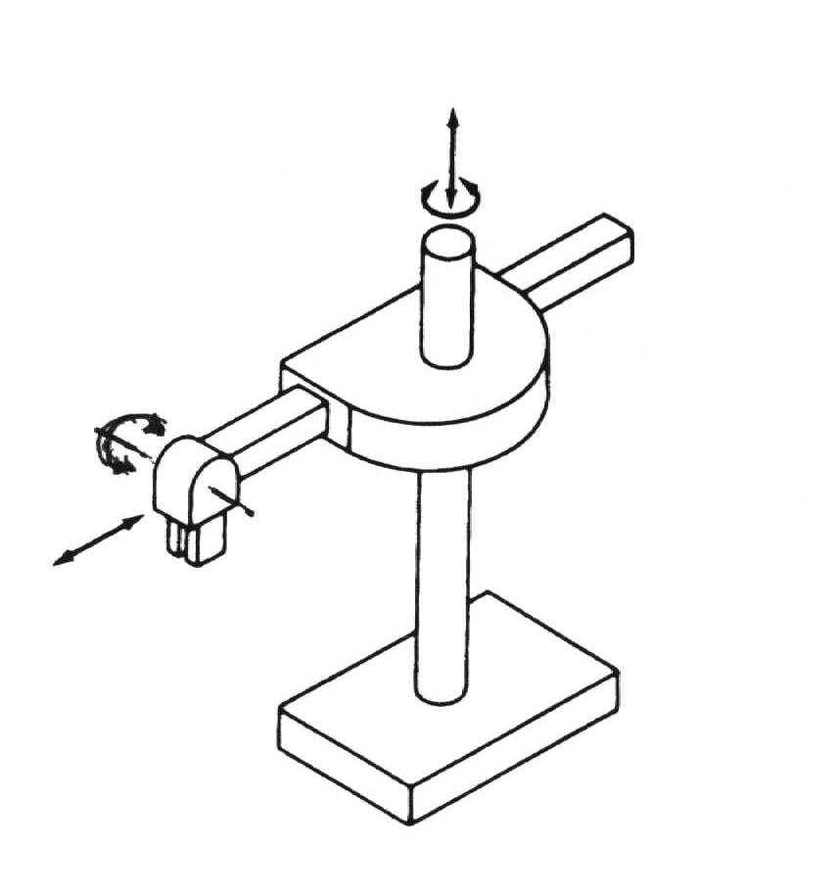
Joint Notation Scheme
T
Physical configuration of robot manipulator can be described by Joint notation scheme (L, R, T, V)
Sequence:
  Start with the arm and body joints; first starting from the joint closest to the base proceeding to the joint that connect the wrist.
  The wrist notation is then added after a “:”
  If the robot is mobile, Joint notation will be added first before a “-”
R
R
R
TRR:R
L
T
R
L
Source: Groover
TLL:R
IMSE381
Notes:
IMSE 381
E. ORADY
TRR:R (jointed arm)
TLL: R (cylindrical)

Slide 28
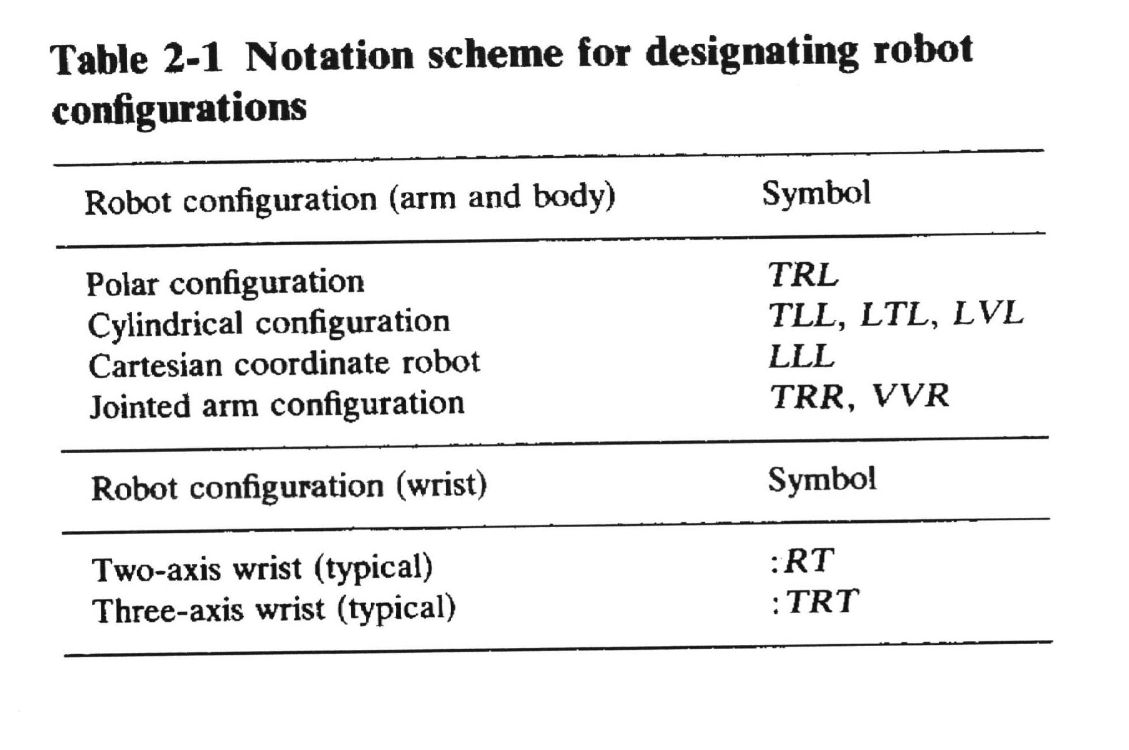
Examples
Source: Groover
IMSE381
Notes:
IMSE 381
E. ORADY

Slide 29
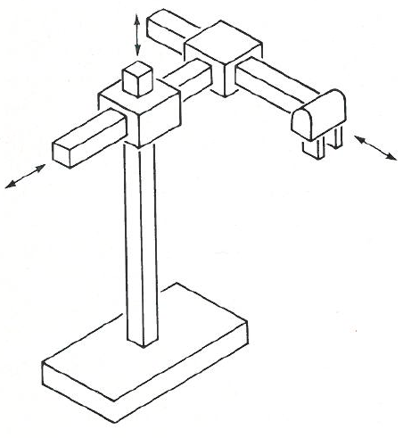
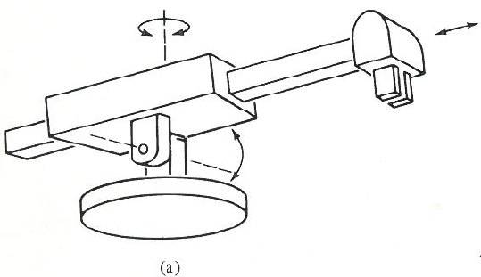
More Examples
Source: Groover
IMSE381
Notes:
TRL (polar or spherical)
LLL (cartesian)
IMSE 381
E. ORADY

Slide 30
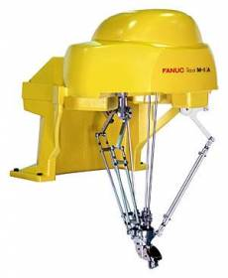
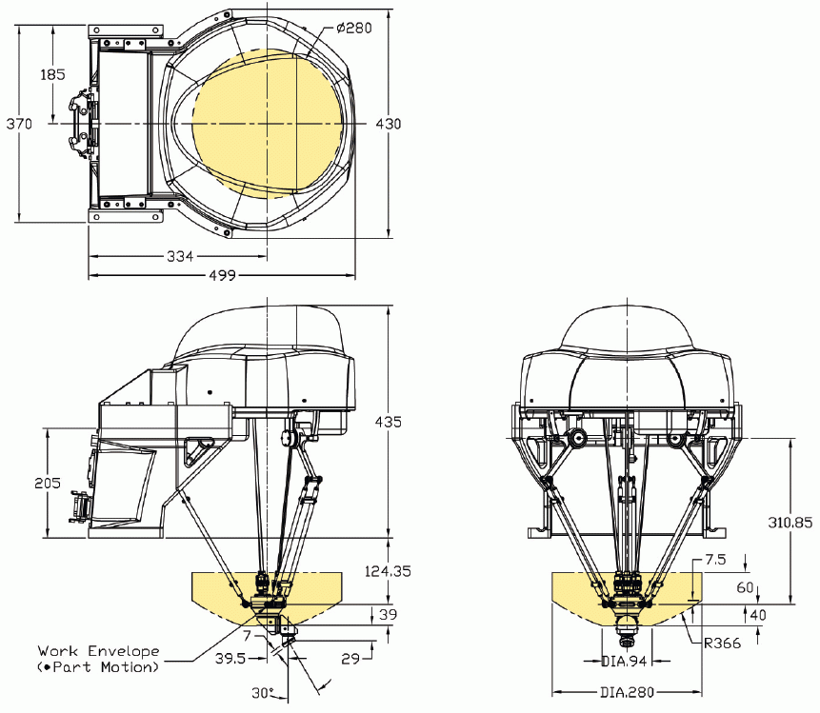
Where does our spider robot belong?
IMSE381

Slide 31
Robot Drive Systems
Three Basic Types
  Pneumatic Drives
  Hydraulic Drives
  Electric Drives
IMSE381
Notes:
IMSE 381
E. ORADY

Slide 32
Pneumatic Drives
Applications
  Small robots with a few d.o.f.
  Limited to pick-and-place and fast cycles
  Can be used to actuate both rotational and translational joints.
IMSE381
Notes:
IMSE 381
E. ORADY

Slide 33
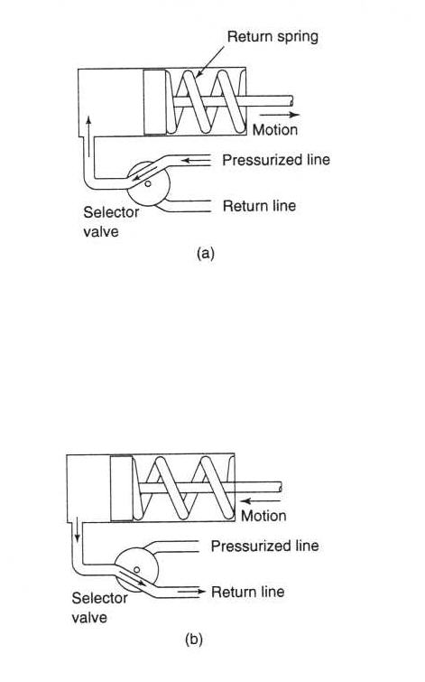
Pneumatic-Power Manipulators
Source: J. L. Fuller
Two types
  Single-action cylinder
  Double-action cylinder
Single-action cylinder
  Force in outward stroke (F)
  F = 0.25πxD²xP - (S+Ff)
  where
  D = cylinder diameter
  P = applied pressure
  S = return spring pressure
  Ff = Friction force of the piston
Power stroke: compressed air
moves the piston against the
return spring
Return Stroke: Return spring position
spring to its original position and
remove air out
IMSE381
Notes:
IMSE 381
E. ORADY

Slide 34
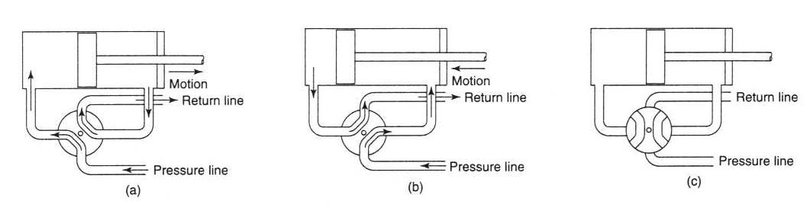
Pneumatic Power: Double-actions Cylinder
Source: J. L. Fuller
Outward Stroke:
Compressed air moves the
piston and removes air
pushes out; the Force is
F=0.25 π xD²xP -Ff
Return Stroke:
Compressed air moves piston
back and empty cylinder in
the other side. The Force is:
F = 0.25πx(D² -Dr²)xP -Ff
Dr = Piston rod diameter
Holding Position:
Holding position with both
sides of piston sealed.
It is function of holding load
IMSE381
Notes:
IMSE 381
E. ORADY

Slide 35
Pneumatic Drives
Advantages
  Relatively inexpensive
  High speed
  They do not pollute the workspace with fluid
  Can be used in laboratory work
Disadvantages
  The compressibility of air limits their accuracy
  Noise pollution
  Air leakage is a major concern
  Additional filtering systems are needed
  Increased maintenance and construction requirements
IMSE381
Notes:
IMSE 381
E. ORADY

Slide 36
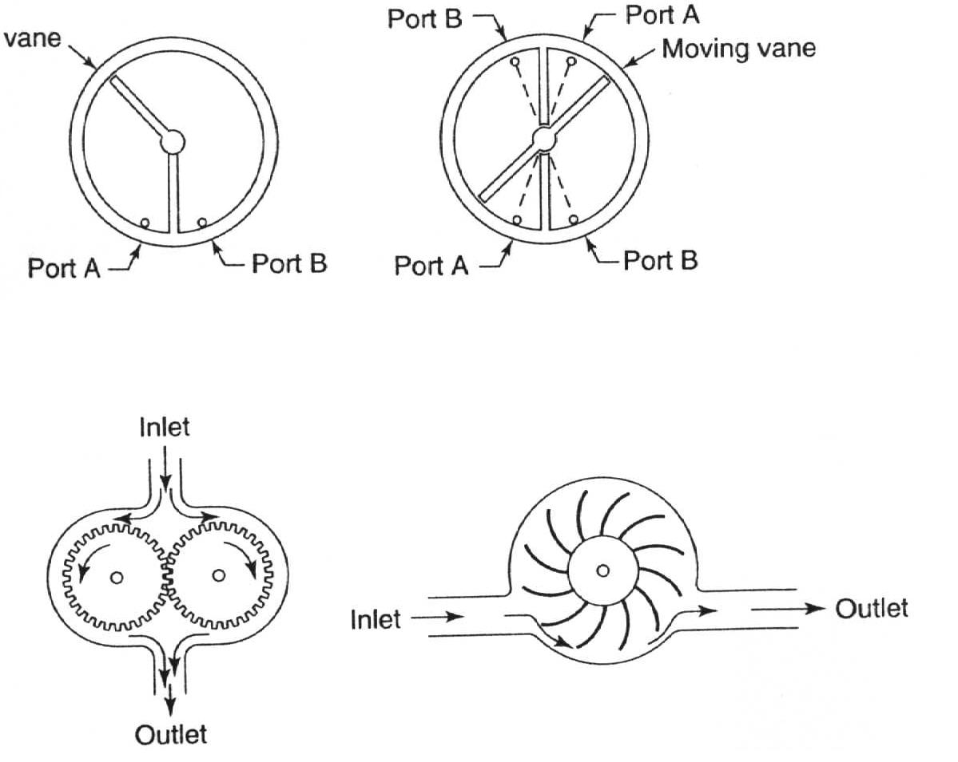
Hydraulic Drives
Source: J. L. Fuller
Hydraulic drives are usually Associate with large robots
Types:
  Linear drives
    single-action cylinder
    double-action cylinder
  Rotary Drives
    Gear drive
    Rotary piston
    Rotary vane motor
Single acting rotary drive Double -action rotary drive
Gear motor Vane motor
IMSE381
Notes:
IMSE 381
E. ORADY

Slide 37
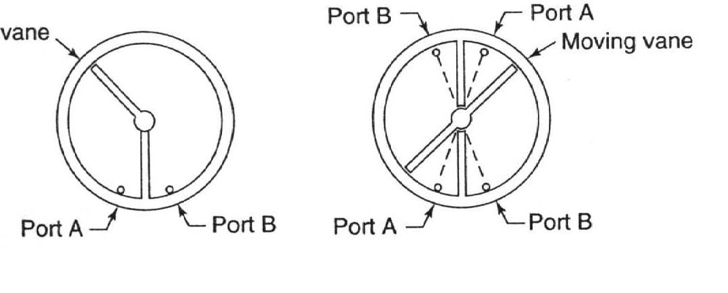
Hydraulic Drives- Rotary Drives
Moving
Source: J. L. Fuller
Single-action vane
Movement range up to 280º
Can Provide Torque (T)
T = (PxAxRc) -Tf
P = Fluid pressure
A = Vane area
Rc = Center radius
Tf = Friction torque
Double-action vane
Moves only through half of the rotation
about 140º
Provides twice the torque since
pressure applied to twice the area
T = (2xPxAxRc) - Tf
IMSE381
Notes:
IMSE 381
E. ORADY

Slide 38
Hydraulic Drives
Advantages
  Large lift capacity
  Moderate speed
  Oil is incompressible; thus provide accurate joint positions
  Offers accurate control
Disadvantages
  Hydraulic systems are expensive
  Pollute workspace with noise and fluid
  Not suitable for high speed cycles.
IMSE381
Notes:
IMSE 381
E. ORADY

Slide 39
Electric Drives
Applications
  Most applicable drives to robots where they provide better accuracy than hydraulic motors
  Small in size, thus can be used with any robot size and provide high maneuvering.
Electric Drives
  DC Motors
  AC Motors
  Stepper Motors
IMSE381
Notes:
IMSE 381
E. ORADY

Slide 40
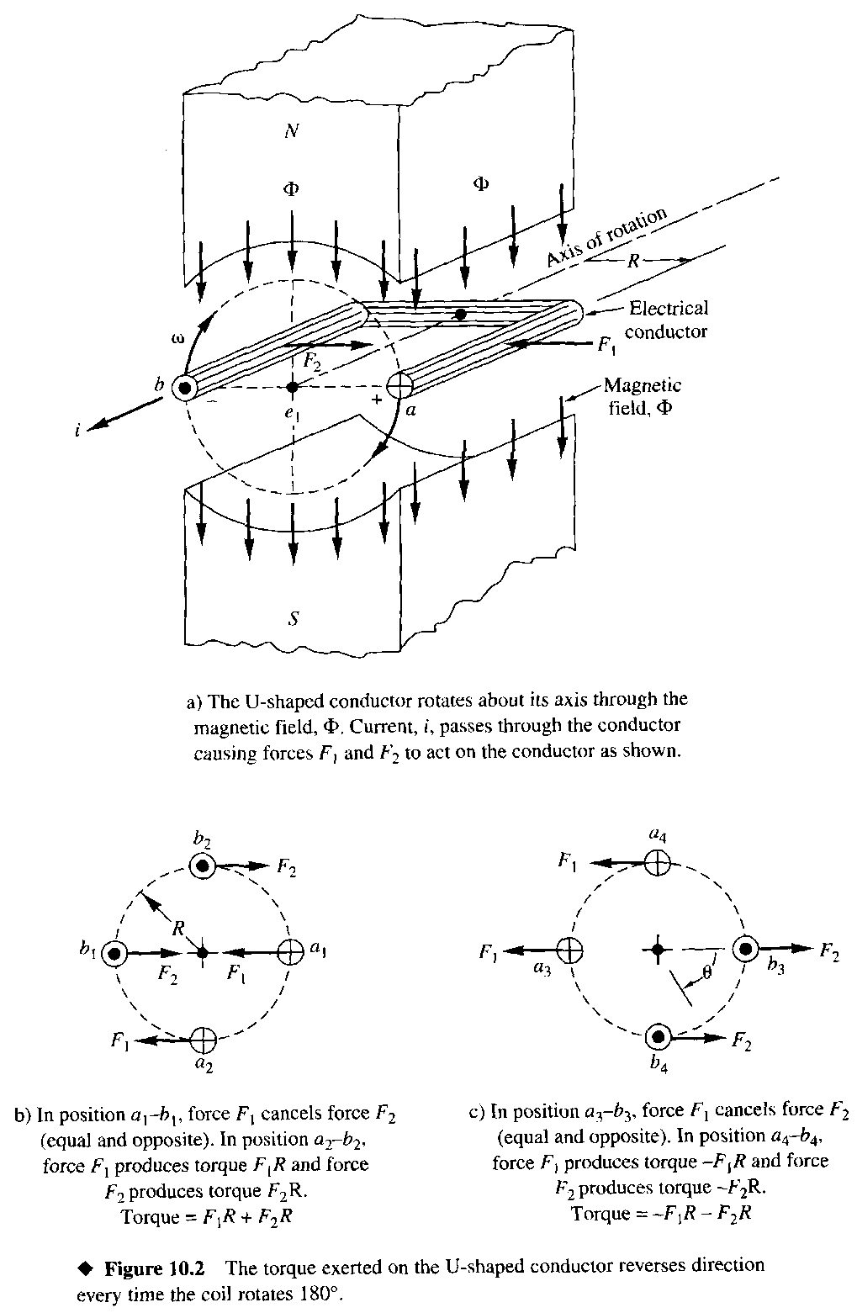
Principle of Operation
Source: Bateson
Need to reverse the direction of the current every 180° to ensure a consistent torque direction

Slide 41
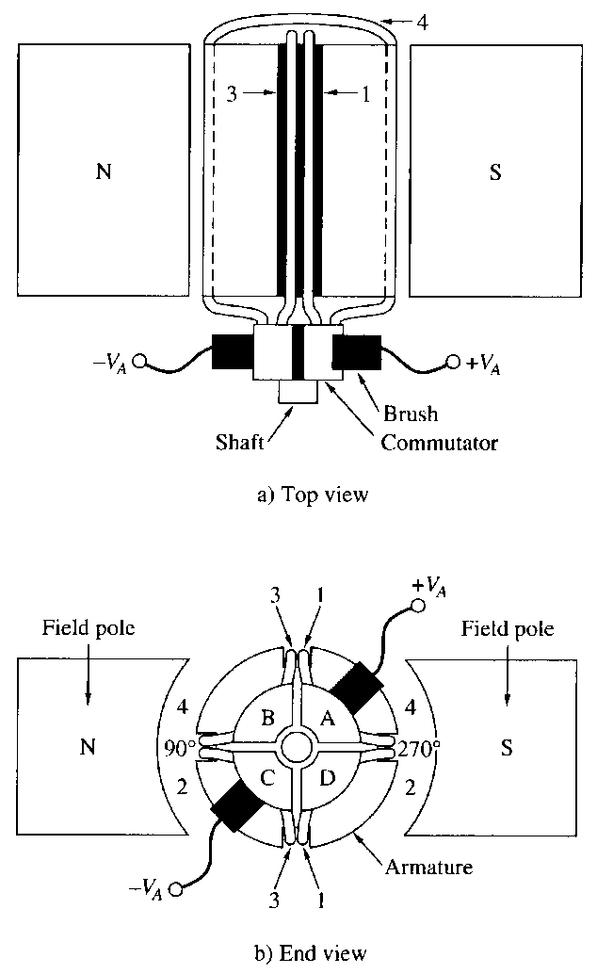
Armature and Commutator
Torque T_{m} = K_{m} I_{a}
T_{m} = torque (N m)
K_{m} = torque constant (N m / A)
i_{a} = armature current (A)
Back emf e_{b} = K_{b} ω
e_{b} = back emf (V)
K_{b} = voltage constant (V s/rad)
ω = rotational speed (rad/s)
Source: Bateson

Slide 42
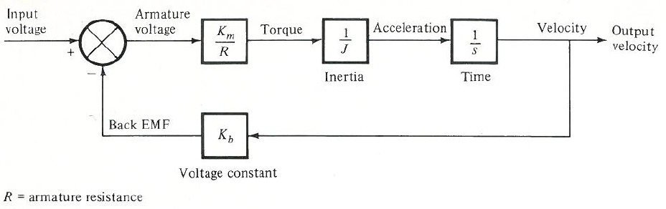
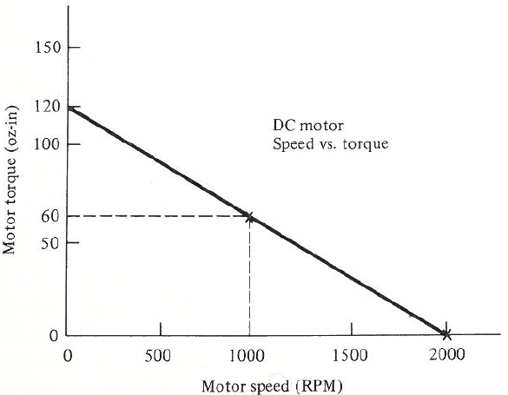
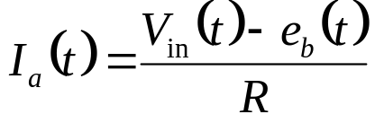
DC Motor Modeling
Source: Groover
Armature current
V_{in} = Input voltage (V)
R = armature resistance (Ω)
(under constant input voltage)
Groover, Fig. 3-19, p 76
Notes:
IMSE 381
E. ORADY

Slide 43
Example Problem
A DC servomotor is used to actuate a robot joint. It has a torque constant of 25 in-lb/A, and a voltage constant of 15 V/Kr/min (1 Kr/min = 1000 rev/min). The armature resistance is 3.0 Ω. At a particular moment during the robot cycle, the joint is not moving and a voltage of 30 V is applied to the motor.
  Determine the torque of the motor immediately after the voltage is applied.
  Assuming no loading torque and ignoring the inductance, determine the maximum theoretical speed of the motor when the input voltage is 30 V.
  If the torque load due to friction and the payload total 72 in-lb, determine the maximum theoretical speed of the motor when the input voltage is 30 V. Assume no effect of inductance from the armature windings.
IMSE381

Slide 44
DC Motors
Easy to control
Can provide smooth torque even at low speeds for excellent positioning accuracy
Can provide high repeatability for robot arm
Can provide high acceleration rate and rapid reversing of motion of robot arm at high speed
IMSE381
Notes:
IMSE 381
E. ORADY

Slide 45
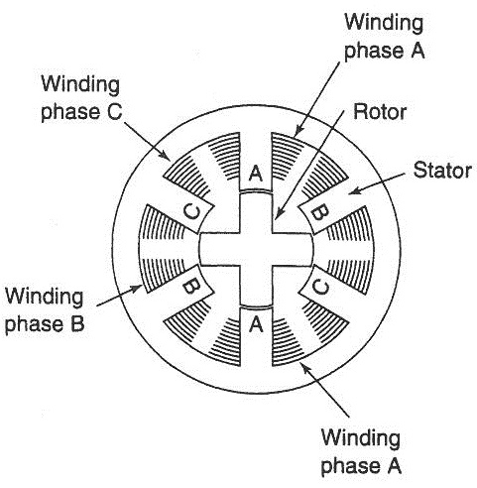
Stepping Motors
Activate phase windings in sequence using pulse signals
  For CCW rotation: A,B,C,A,B,C, …
  For CW rotation: A,C,B,A,C,B …
The resolution of the motor is determined by the number of poles in the stator and rotor
  ex) The resolution of the motor in Fig. 4-6 is 12. Step angle of the motor is 360/12 = 30º.
Source: Fuller
IMSE381
Notes:
IMSE 381
E. ORADY

Slide 46
Stepping Motors
Operate by pulse signals, thus it is most closer to digital systems
Easy to control, thus it is used in wide variety of applications including robots
Small in size and power thus it is limited to small size robots
IMSE381
Notes:
IMSE 381
E. ORADY

Slide 47
AC Motor
Characteristics
  Cost effective
  Convenient
  No commutator (brushless)
  Constant-speed operation (according to the frequency of AC supply)
  Can perform like the DC servomotors if properly controlled.
Two types
  Synchronous
  Asynchronous

Slide 48
Speed Control of AC Motor
Need to change the frequency of AC supply
Normal AC power supply works at a fixed frequency such as 60Hz
Need a variable frequency power for speed control e.g. pulse width modulator (PWM)

Slide 49
Electric Actuators
Advantages
  Fast and accurate
  Possible to apply sophisticated control techniques
  Easily available and relatively inexpensive
  Simple to use
Disadvantages
  Require power transmission systems such as gear trains,
  Gear backlash limits precision
  Electrical arcing might be a problem
  Limited power for large robots.
IMSE381
Notes:
IMSE 381
E. ORADY

Slide 50
Power Transmissions
Reasons for needing power transmissions
  In many cases, it is not possible to find an actuator with the exact speed-torque characteristics that are required
  In other cases, it is necessary to locate the actuator away from the intended joint of the manipulator
Functions of power transmissions
  Transmit power at a distance
  Act as a power transformer
Examples of power transmissions
  Belts, pulleys, chains, gears, screw, etc
IMSE381
Notes:
IMSE 381
E. ORADY

Slide 51
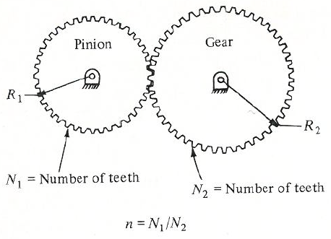
Power Transmissions - Gears
Spur gear train
Source: Groover
Most commonly used
Let the Gear ratio, n is given by n = N₁/N₂
The speed of the output with respect to the input is w_{o} = nw_{in}
,where w_{o} = output speed and w_{in} = input speed
The output torque is T_{o} = T_{in}/n
IMSE381

Slide 52
Power Transmissions
Undesirable effects of power transmissions
  Add ‘compliance’ to the robot system
  e.g. bending of gear train and deflection of bearing supports under load
  ‘Backlash’ or hysteresis in the transmission (e.g. due to space between gear teeth mesh) resulting in output not corresponding directly to input
Both contribute to mechanical inaccuracies that degrade a robot’s ability to position its end-effector to a desired location
IMSE381

